Slide 1






Software Engineering: Development Methodologies 5

Slide 2

Software Design Patterns:
Mastering Reusable Solutions
  Objective: Understand the conceptual foundation and practical application of design patterns.
2

Slide 3
What is a Design Pattern?
  A formal solution to a recurring problem in software design.
  Definition: A description of communicating objects and classes that are customized to solve a general design problem in a particular context.
  Key Insight: Patterns are not code; they are templates for how to solve a problem that can be used in many different situations.
3

Slide 4
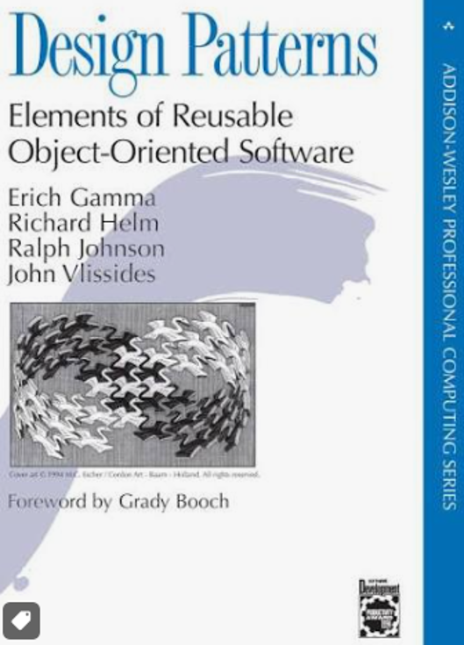
History and Origin
  Inspired by Christopher Alexander’s architectural patterns.
  The "Gang of Four" (GoF): Erich Gamma, Richard Helm, Ralph Johnson, and John Vlissides (1994).
  Design Patterns: Elements of Reusable Object-Oriented Software.
4

Slide 5
Anatomy of a Design Pattern
Name: Provides a vocabulary for designers.
Problem: When to apply the pattern.
Solution: The elements that make up the design, their relationships, and collaborations.
Consequences: Results and trade-offs of applying the pattern.
5

Slide 6
Why Use Design Patterns?
  Reuse: Avoid reinventing the wheel.
  Communication: Shared terminology for developers.
  Quality: Proven solutions lead to more robust systems.
  Maintainability: Easier to refactor and evolve systems designed with standard patterns.
6

Slide 7
Categorizing Patterns (The GoF approach)
  Creational: Focus on object creation mechanisms.
  Structural: Focus on object composition and class structure.
  Behavioral: Focus on communication and responsibility
  assignment between objects.
7

Slide 8
Creational Patterns: Overview
  Goal: Abstract the instantiation process.
  Make a system independent of how its objects are created, composed, and represented.
8

Slide 9
Singleton Pattern
  Problem: Ensure a class has only one instance and provide a global point of access.
  Solution: Private constructor, static instance variable, and getInstance() method.
  Use case: Configuration managers, logging services.
9

Slide 10
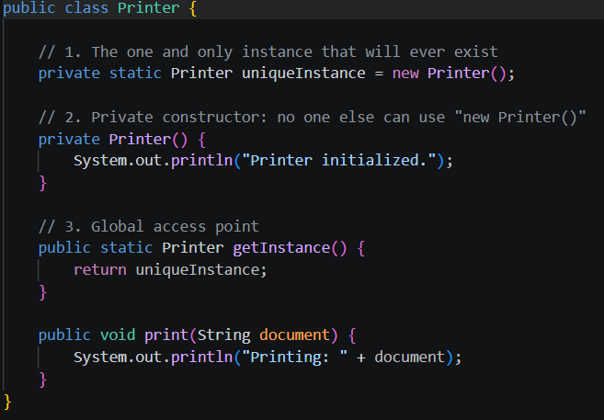
9

Slide 11
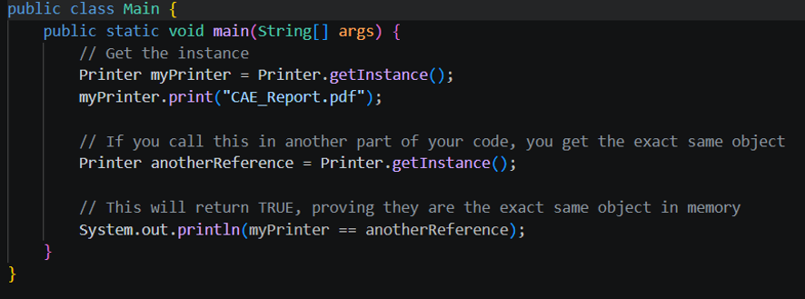
9

Slide 12
Factory Method
  Problem: Define an interface for creating an object, but let subclasses decide which class to instantiate.
  Benefits: Decouples the creator from the specific product.
10

Slide 13
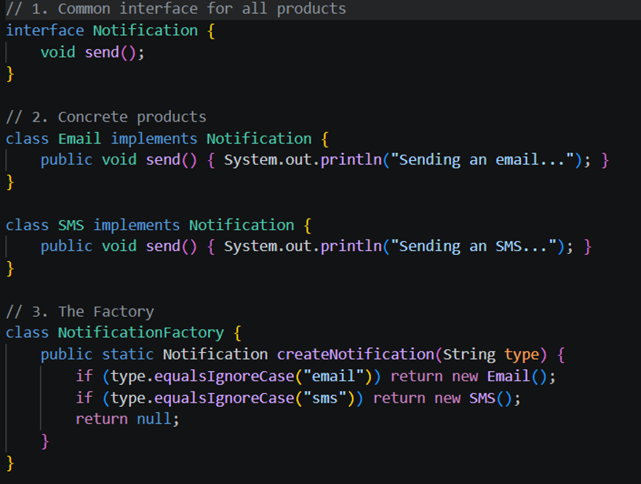
9

Slide 14
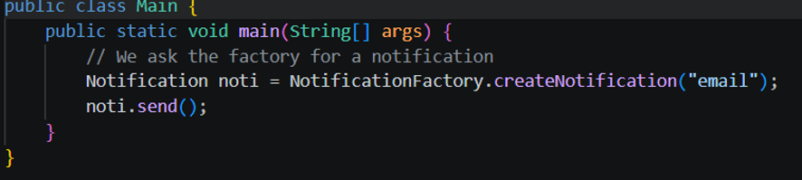
9

Slide 15
Abstract Factory
  Problem: Provide an interface for creating families of related or dependent objects without specifying their concrete classes.
  Context: UI Toolkits (e.g., buttons and scrollbars for both Windows and Mac).
11

Slide 16
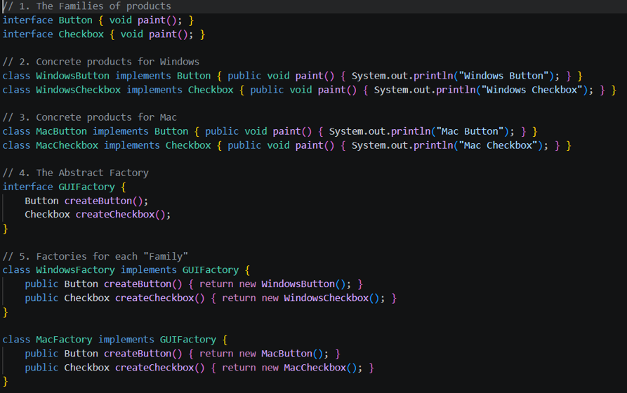
9

Slide 17
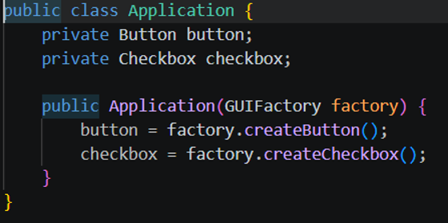
9

Slide 18
Builder Pattern
  Problem: Separate the construction of a complex object from its representation.
  Benefit: Allows the same construction process to create different representations (e.g., building complex SQL queries).
12

Slide 19
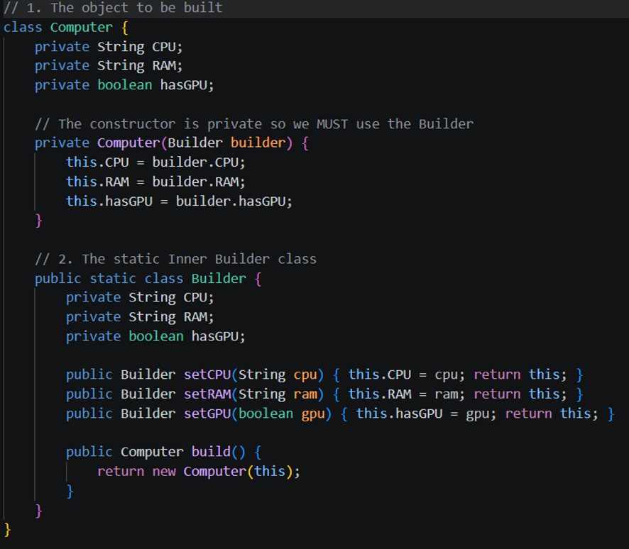
9

Slide 20
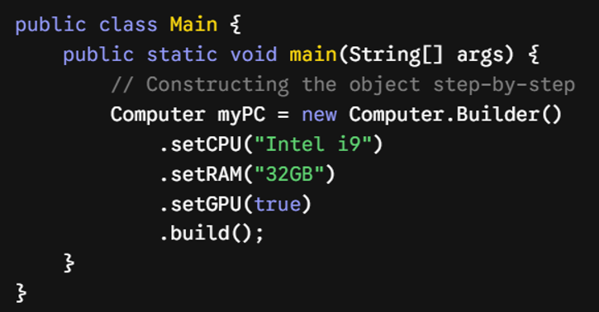
9

Slide 21
Prototype Pattern
  Problem: Create new objects by cloning an existing instance.
  Use case: When creation is costly or complex.
13

Slide 22
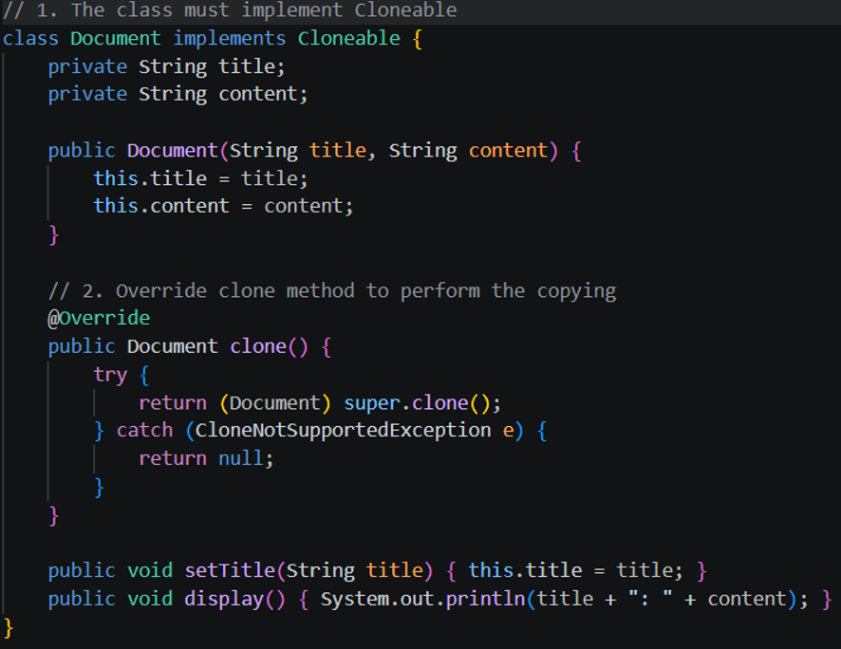
9

Slide 23
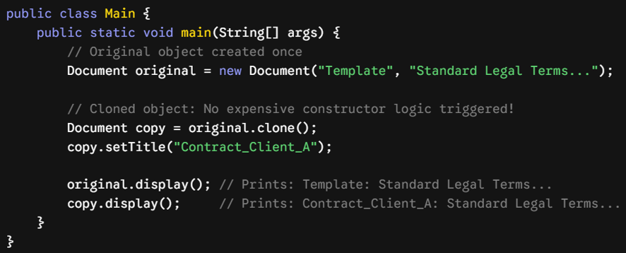
9

Slide 24
Structural Patterns: Overview
  Goal: How classes and objects are composed to form larger structures.
  Focus on simplifying relationships between entities.
14

Slide 25
Adapter Pattern
  Problem: Allow incompatible interfaces to work together.
  Mechanism: Wraps an existing class with a new interface.
3

Slide 26
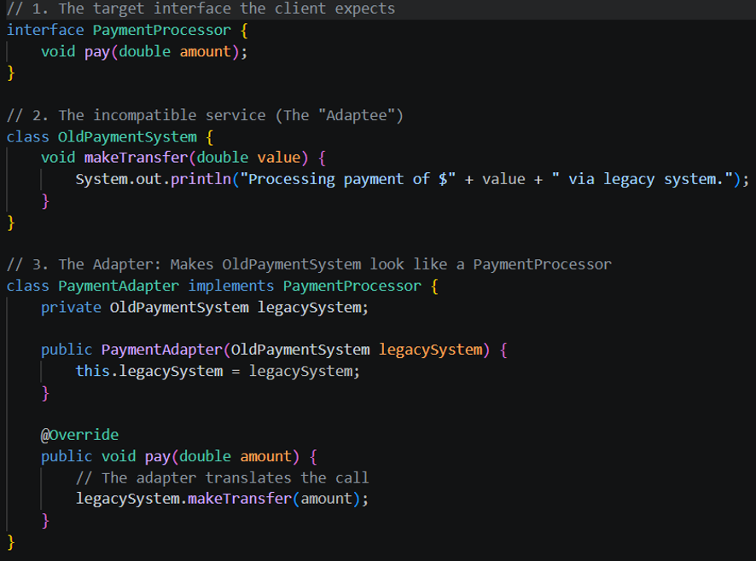
9

Slide 27
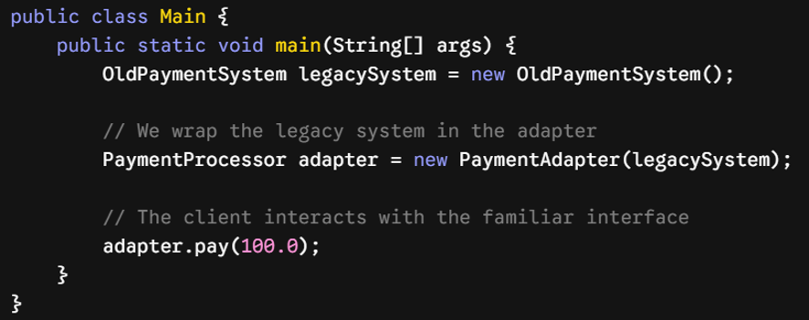
9

Slide 28
Composite Pattern
  Problem: Compose objects into tree structures to represent part-whole hierarchies.
  Effect: Clients treat individual objects and compositions uniformly.
16

Slide 29
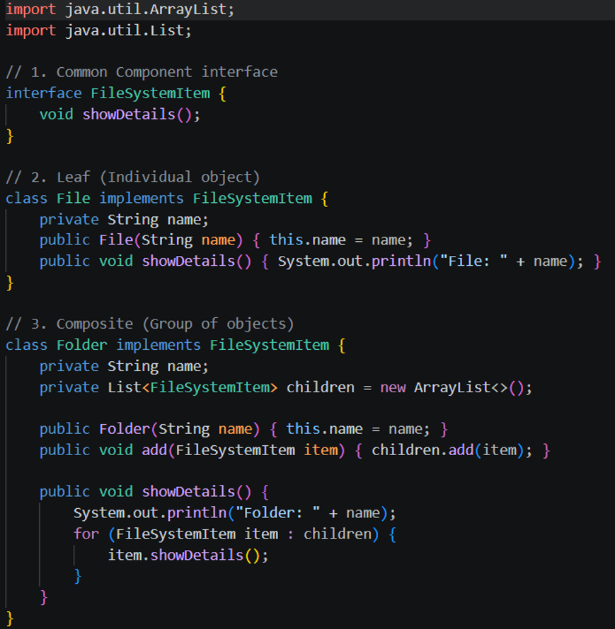
9

Slide 30
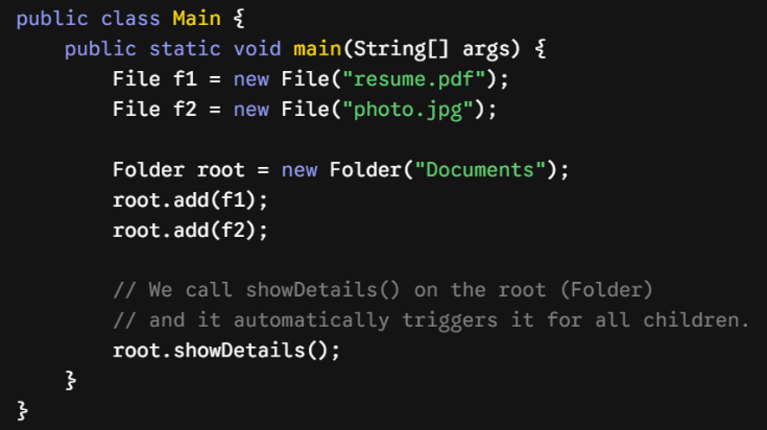
9

Slide 31
Decorator Pattern
  Problem: Attach additional responsibilities to an object dynamically.
  Advantage: Flexible alternative to subclassing for extending functionality.
17

Slide 32
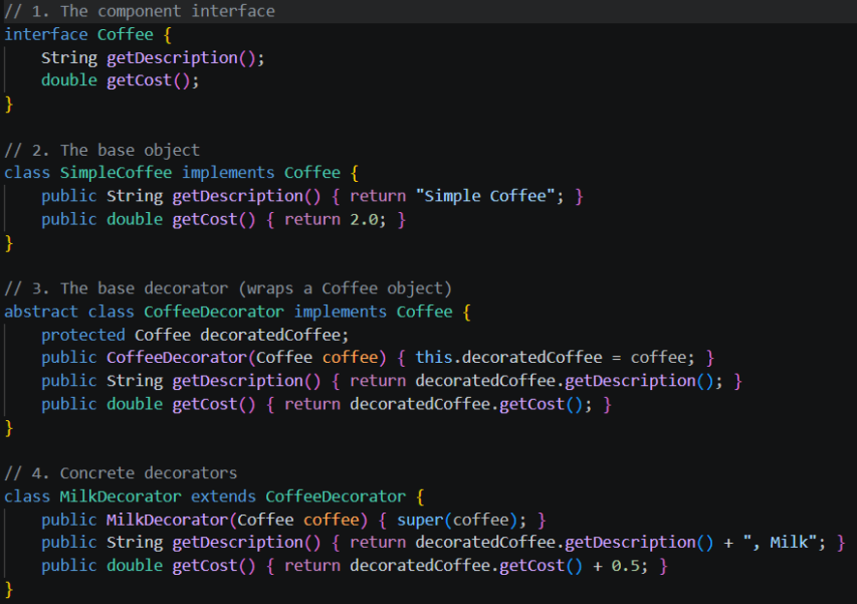
9

Slide 33
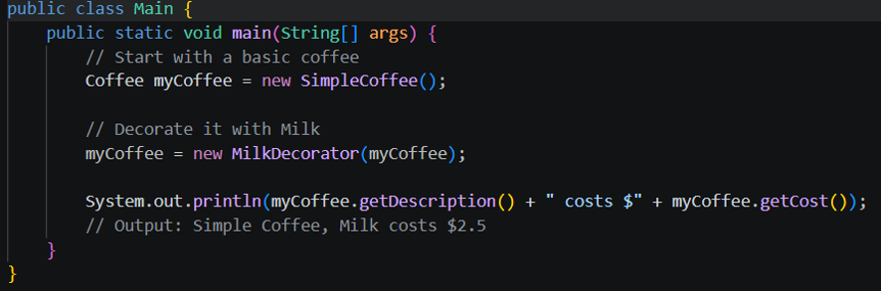
9

Slide 34
Facade Pattern
  Problem: Provide a unified interface to a set of interfaces in a subsystem.
  Goal: Reduce complexity by providing a "front" to a complicated system.
18

Slide 35
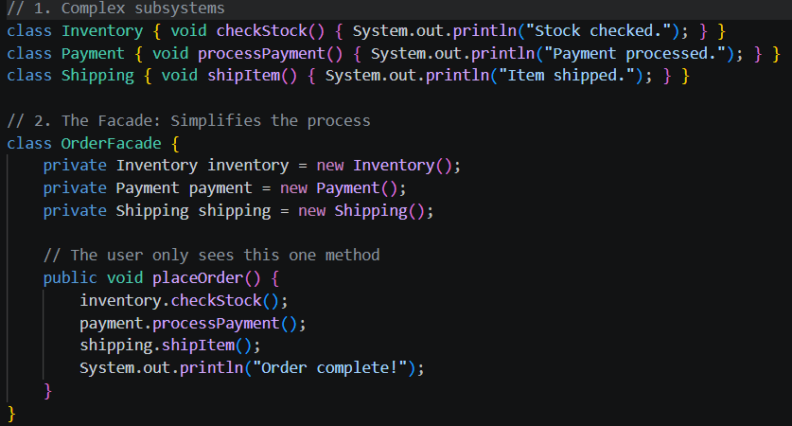
9

Slide 36
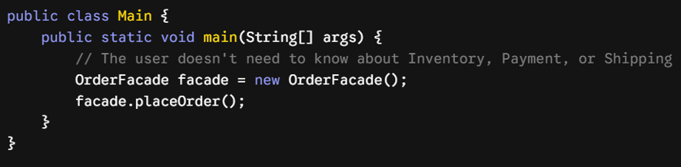
9

Slide 37
Proxy Pattern
  Problem: Provide a surrogate or placeholder for another object to control access.
  Types: Virtual proxy (lazy loading), Protection proxy (security).
19

Slide 38
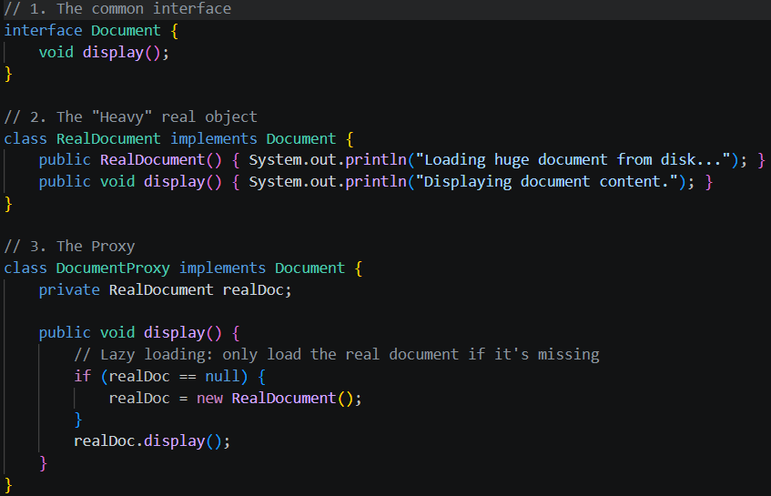
9

Slide 39
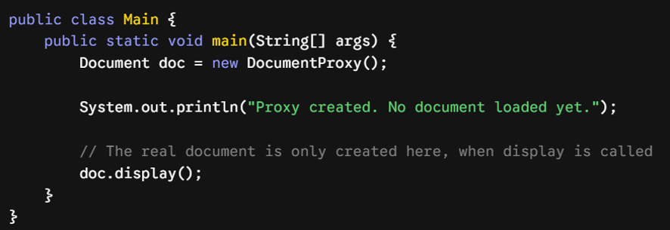
9

Slide 40
Behavioral Patterns: Overview
  Goal: Concerns algorithms and the assignment of responsibilities between objects.
  Focus on how objects interact and distribute control.
20

Slide 41
Observer Pattern
  Problem: Define a one-to-many dependency so that when one object changes state, all dependents are notified.
  Use case: MVC architectures, event-driven systems.
20

Slide 42
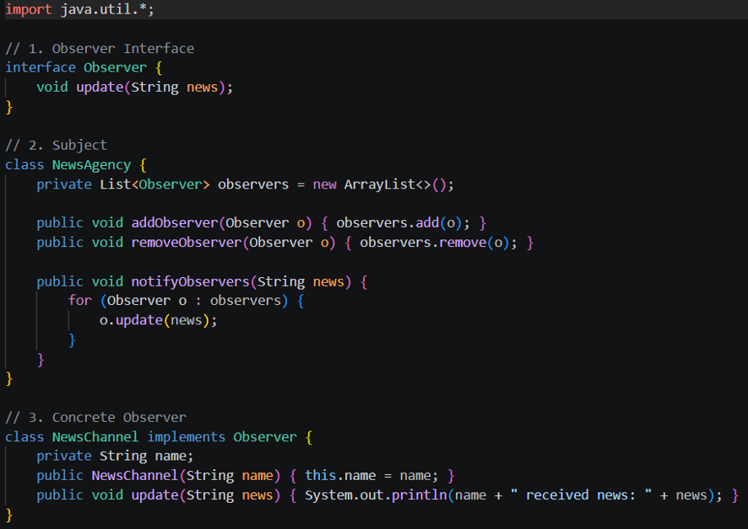
9

Slide 43
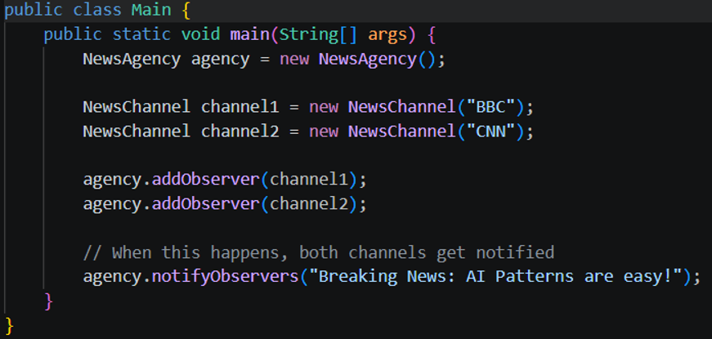
9

Slide 44
Strategy Pattern
  Problem: Define a family of algorithms, encapsulate each one, and make them interchangeable.
  Benefit: Allows the algorithm to vary independently from the client that uses it.
21

Slide 45
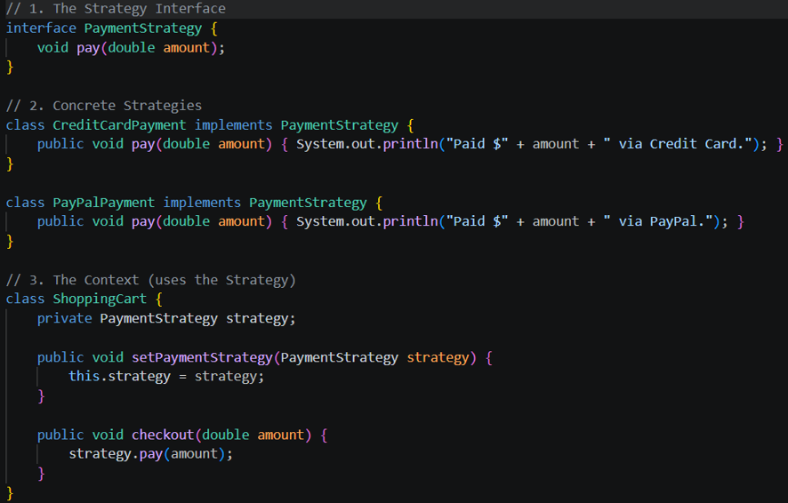
9

Slide 46
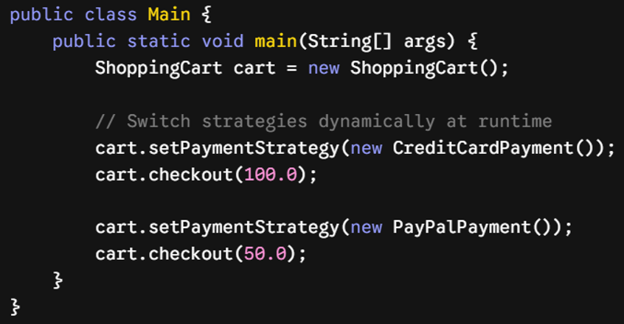
9

Slide 47
Command Pattern
  Problem: Encapsulate a request as an object, thereby letting you parameterize clients with different requests.
  Application: Undo/redo functionality, job queues.
22

Slide 48
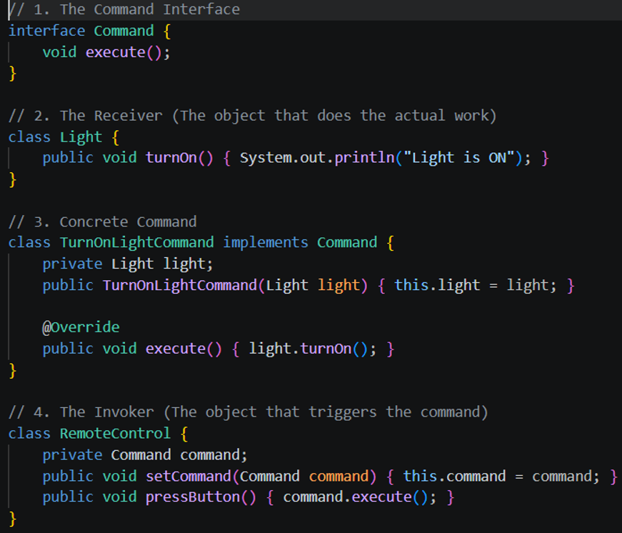
9

Slide 49
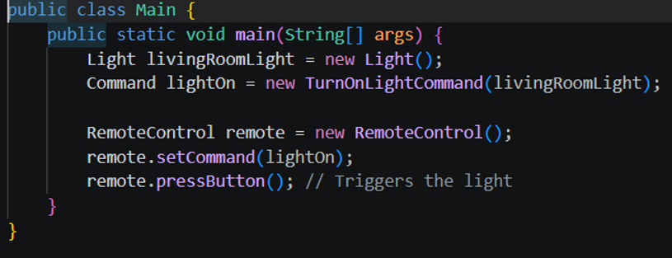
9

Slide 50
State Pattern
  Problem: Allow an object to alter its behavior when its internal state changes.
  Benefit: Avoids massive if-else or switch statements.
23

Slide 51
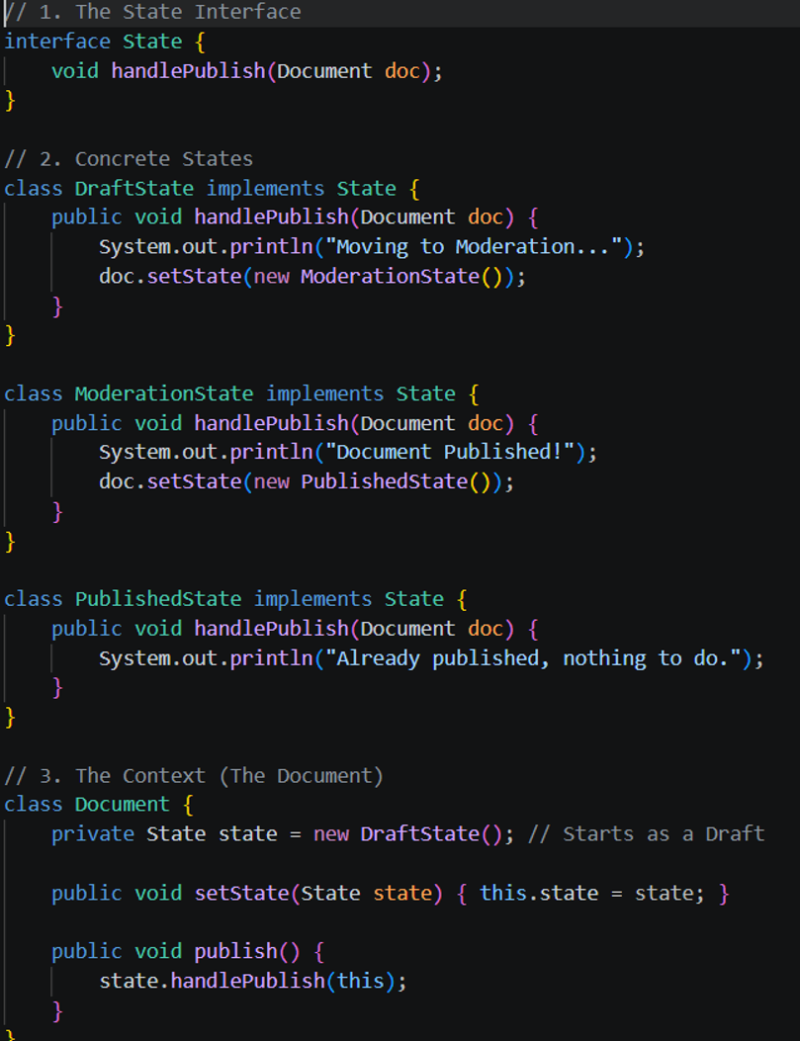
9

Slide 52
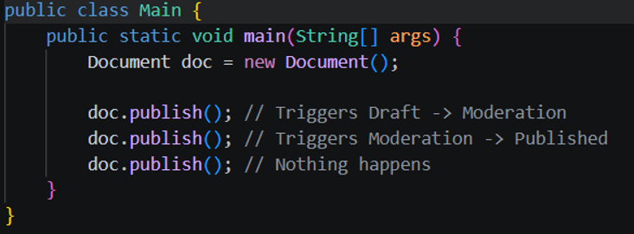
9

Slide 53
Template Method
  Problem: Define the skeleton of an algorithm in an operation, deferring some steps to subclasses.
  Use case: Frameworks where core logic is fixed, but specific steps vary.
24

Slide 54
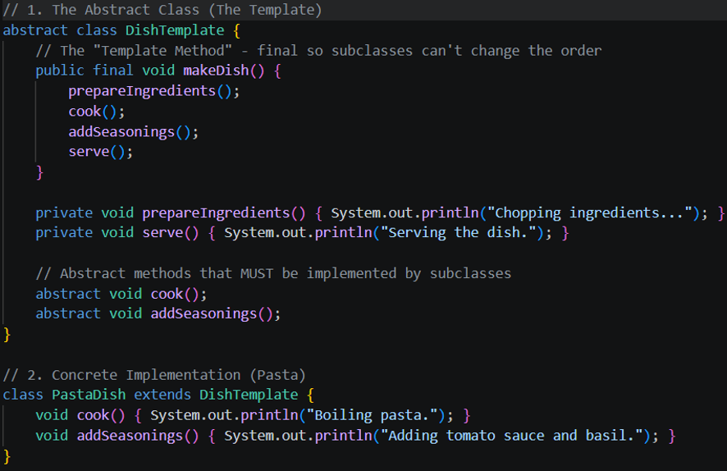
9

Slide 55
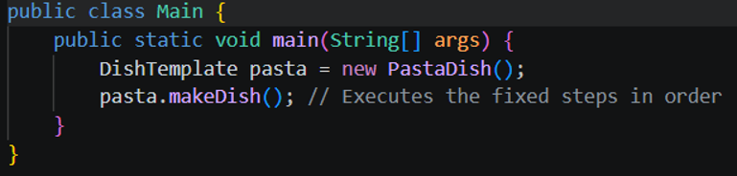
9

Slide 56
Iterator Pattern
  Problem: Provide a way to access the elements of an aggregate object sequentially without exposing its underlying representation.
25

Slide 57
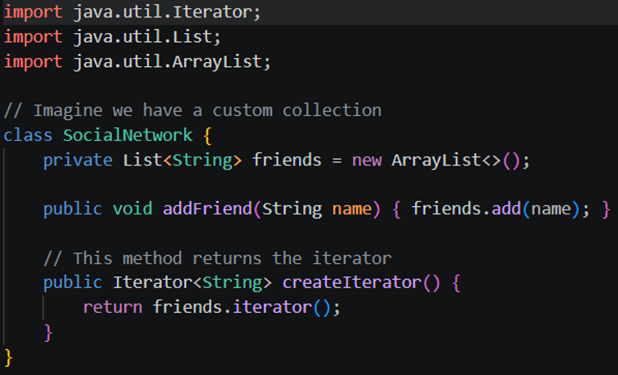
9

Slide 58
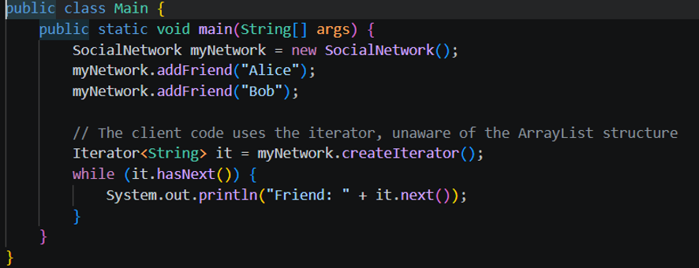
9

Slide 59
Challenges and Pitfalls
  Over-engineering: Using a pattern when a simple solution suffices.
  Complexity: Patterns add abstractions that can increase the learning curve for new developers.
  Context Sensitivity: A pattern that works in one language (e.g., Java) might be redundant in another (e.g., Python/Functional languages).
25

Slide 60
Patterns and Modern Software Development
  How patterns adapt to Cloud-native architectures (Microservices patterns).
  Patterns in reactive programming.
  Evolution from class-based patterns to component-based thinking.
25

Slide 61
Conclusion
  Design patterns are a tool, not a dogma.
  Understand the intent of the pattern rather than memorizing the class diagram.
  Practice: The best way to learn is to refactor existing code.
25

Slide 62
Thank you for your attention
31

